Slide 1
Processes & Threads InterProcess Communication (IPC)

Slide 2
Review
Process Model
Pseudo-parallelism (Multi-programming, quantum or time slice)
Context Switch (user mode ↔ kernel mode, switch CPU to other process – load/store PCB)
Scheduling algorithm
PCB
Id, registers, scheduling information, memory management information, accounting information, I/O status information, …
State (New, Running, Ready, Blocked, Terminal)
CPU Utilization
Shows the CPU utilization
1 – p^{n}

Slide 3
Review
Threads
Share the same address space and resources of the process
Each thread has its own PC, registers and stack of execution
There is no protection between threads in one process
Have its own stack
Improve context switch among processes, optimize quantum
Are implemented in 3 modes: user, kernel, hybrid

Slide 4
Objectives…
Interprocess communication
Overview
Race Conditions
Critical Regions
Mutual Exclusion with Busy Waiting
Disable Interrupts
Lock Variables
Strict Alternative
Peterson’s solution
TSL instructions
Sleep and wakeup
Semaphores
Mutexes
Monitors
Message Passing
Barries

Slide 5
InterProcess Communication (IPC) Overview
How one process can pass information to another?
Make sure two or more processes do not get in each other’s way
Proper sequencing when dependencies are present: if process A produces data and process B prints them, B has to wait until A has produced some data before starting to print
Context
Why does the C/ C++ compiler resist the back door pointer?
Why do the object give the shallow (pass/return by reference) or deep copy (pass/return by value) way to implement it?

Slide 6
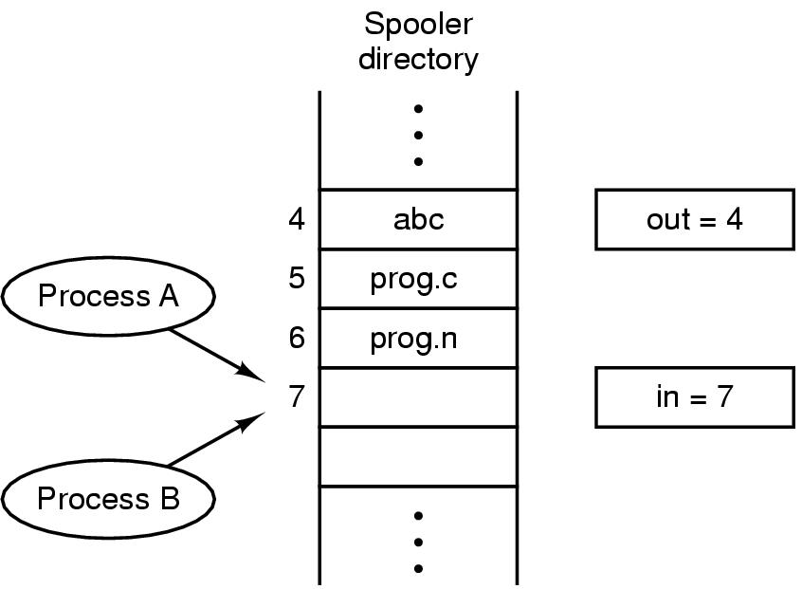
InterProcess Communication (IPC) Race Conditions
A situation where several threads (or processes) manipulate the same (shared) data concurrently and the outcome of the execution depends on the precise order of what is happening when, is called a race condition
Ex
Other example in practically
The bank account has the balance as 800, and can withdraw with 2 ATM cards at different 2 locations at a time
First, the user1 pushes card to ATM machine and checking account’s balance. The process P1 is created simultaneously in server. Then the checking result is 800. The user choose withdrawing 400
Second, in the other location, the user2 also do same things as user1 and process P2 is created. The user choose withdrawing 500
In the case, if the P1 is out of time slice, the P2 is served first then user 2 gets 500. Later, does the user1 get 400 or get the error message?
The final state of a resource is unpredictable and could be inconsistent
Tanenbaum, Fig. 2-21.

Slide 7
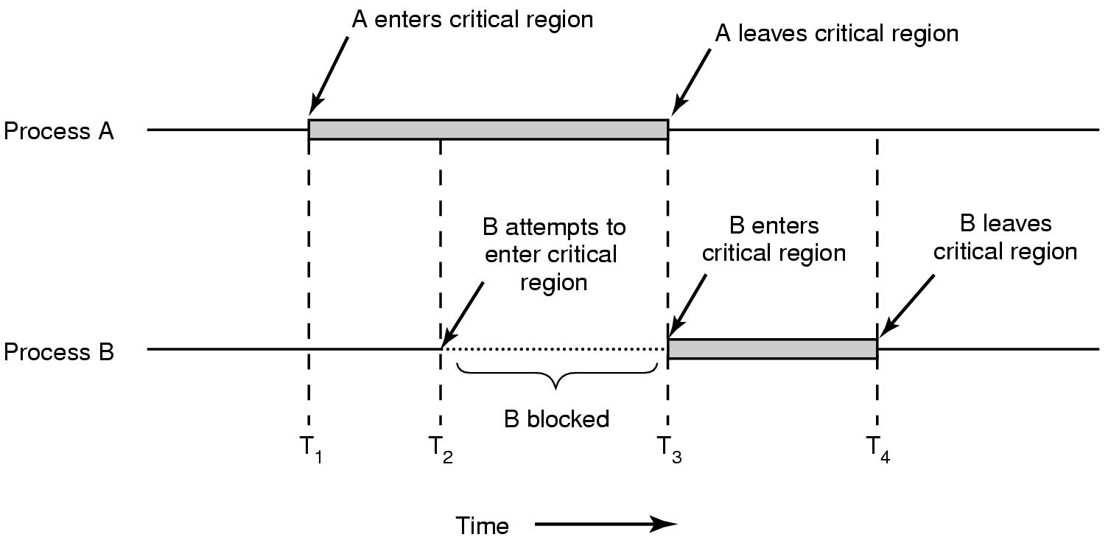
InterProcess Communication (IPC) Critical Regions
The part of program where the shared memory is accessed (The code regions where race conditions appear)
Are the areas of code whose execution must be regulated to guarantee predictable results
To avoid races, we could arrange matters such that no two processes were ever in their critical regions
Conditions required to avoid race condition:
No two processes may be simultaneously inside their critical regions.
No assumptions may be made about speeds or the number of CPUs.
No process running outside its critical region may block other processes.
No process should have to wait forever to enter its critical region.
Tanenbaum, Fig. 2-22.

Slide 8
InterProcess Communication (IPC) Mutual Exclusion with Busy Waiting
Mutual Exclusion
If one thread is executing in its critical section, no other threads can be executing in their critical sections (Only one process can use a shared resource at one moment)
Proposals for achieving mutual exclusion:
Disabling interrupts
Lock variables
Strict alternation
Peterson's solution
The TSL instruction
Sleep and Wakeup
Producer & Consumer
Semaphore, Mutex, Monitor
Barrier

Slide 9
InterProcess Communication (IPC) A study problem
Time
Person A
Person B
3:00
Look in fridge. Run out of milk.
3:05
Go to the store.
3:10
Arrive at store.
Look in fridge. Run out of milk.
3:15
Buy milk.
Go to the store.
3:20
Arrive home, put milk away.
Arrive at store.
3:25
Buy milk.
3:30
Arrive home, put milk away.
Not a good cooperation => Too much milk.
Correctness requirements
Never more than one person buys milk (First Rule)
Someone buys if needed (Fourth Rule)
This solution of this case (mutual exclusion) is called an synchronization

Slide 10
InterProcess Communication (IPC) Disabling Interrupts
On a single-processor system, each process
Disable all interrupts just after entering its critical region
Re-enable them just before leaving it
→ A process can examine and updated shared memory without fear that any other process will intervene
Disadvantages
Give user processes the power to turn off interrupts (if a process dies while it is in its critical region → the system is indefinitely blocked)
On a multiprocessor, the disabling interrupts affects only the CPU that executed the disable instruction while the other ones will continue running and can access the shared memory
→ Disabling interrupts is often a useful technique within the OS itself but is not appropriate for user processes

Slide 11
InterProcess Communication (IPC) Lock Variables
while(TRUE) {
while (lock == 1); //waiting until lock sets to 0
lock = 1;
critical_region();
lock = 0;
nonCritical_region();
}
Process 1 | Process 2
while(TRUE) { while (lock == 1); lock = 1; critical_region(); lock = 0; nonCritical_region(); } | while(TRUE) { while (lock == 1); lock = 1; critical_region(); lock = 0; nonCritical_region(); }

Slide 12
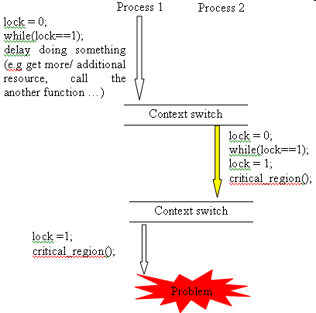
InterProcess Communication (IPC) Lock Variables
The solution fails occasionally
both processes can be simultaneously in their own critical regions
Process A reads the lock and sees that it is 0
Before it can set the lock to 1, Process B is scheduled, run, and set the clock to 1 (then Process A set the clock to 1)
Testing a variable until some value appears is called busy waiting (wastes CPU time)

Slide 13
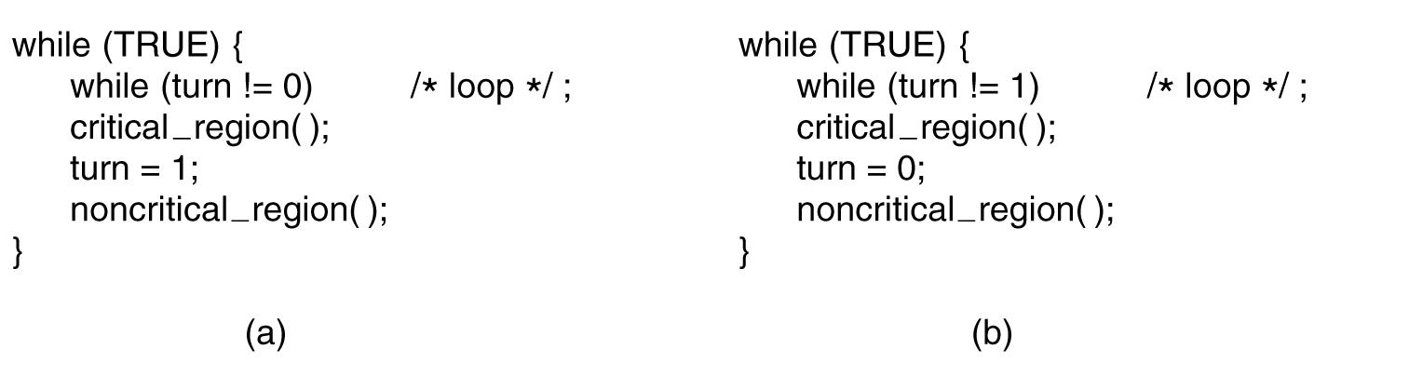
InterProcess Communication (IPC) Strict Alternation
Tanenbaum, Fig. 2-23.
The two processes strictly alternate in entering their critical regions
Problems
Testing a variable until some value appears is called busy waiting (wastes CPU time)
A process is being blocked by another process not in its critical region
One of processes is much slower than the other
When one process dies, the other ones are blocked forever

Slide 14
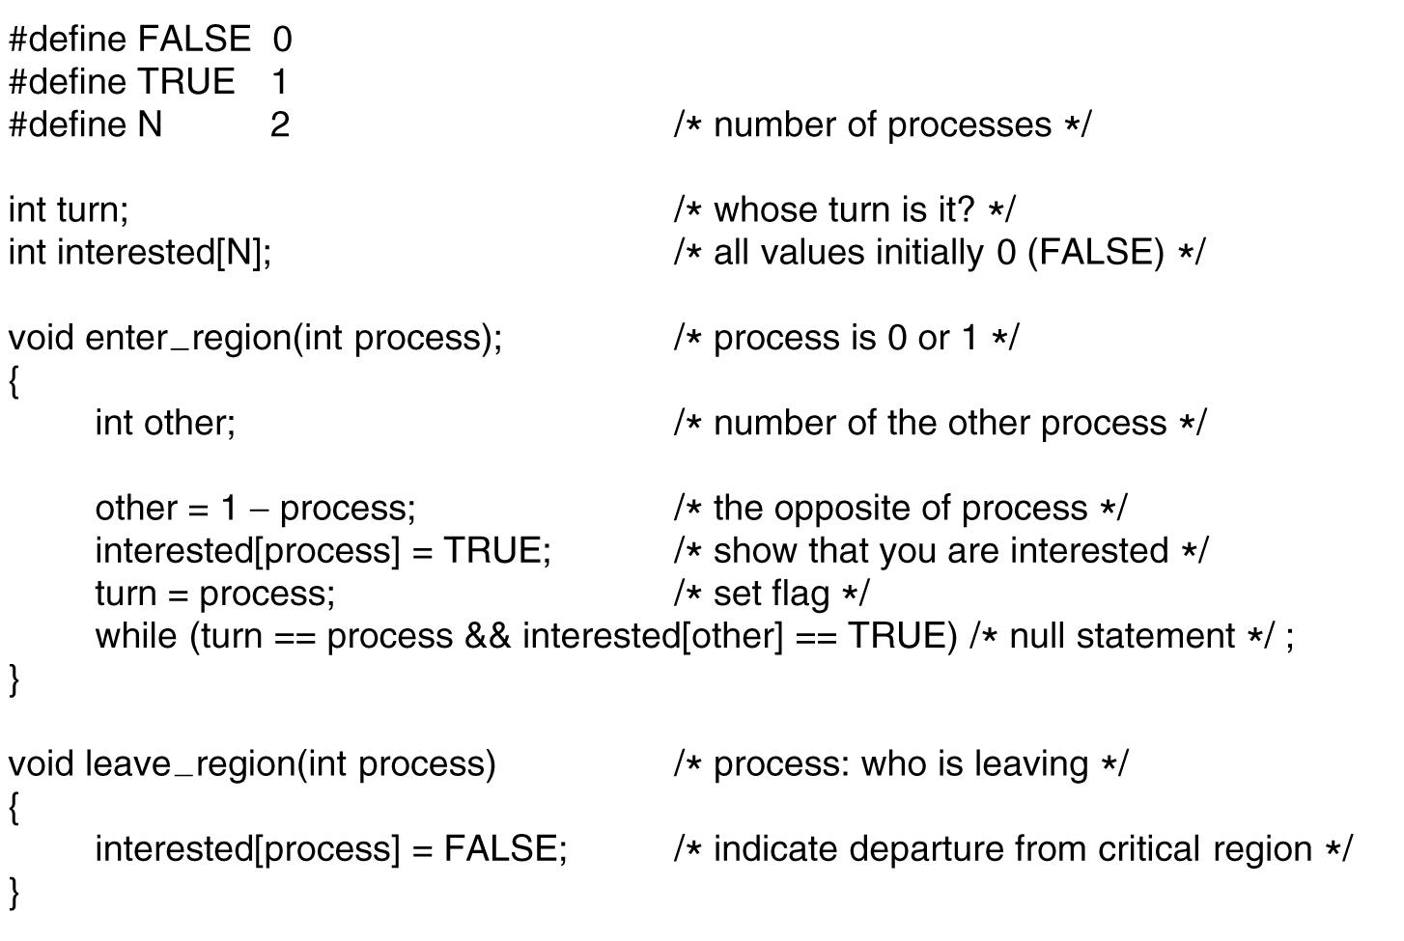
InterProcess Communication (IPC) Peterson’s Solution
Tanenbaum, Fig. 2-24.
Combines the idea of taking turns with the idea of lock variables and strict alternation

Slide 15
InterProcess Communication (IPC) Peterson’s Solution
Solution for process Pi
do {
enter_region(i);
critical_region();
leave_region(i);
nonCritical_region();
} while (TRUE);
Mutual exclusion is preserved (1st rule)
Pi enters its critical section only if either interested [j]=false or turn=j.
If both processes want to enter their critical sections at the same time, then interested [i] = interested [j] = true.
However, the value of turn can be either 0 or 1 but cannot be both. Hence, one of the processes must have successfully executed the while statement (to enter its critical section), and the other process has to wait, till the process leaves its critical section → mutual exclusion is preserved.

Slide 16
InterProcess Communication (IPC) Peterson’s Solution
The 3rd rule is satisfied.
Case 1:
Pi is ready to enter its critical section.
If Pj is not ready to enter the critical section (it is in the remainder section).
Then interested[j] = false, and Pi can enter its critical section.
Case 2:
Pi and Pj are both ready to enter its critical section.
interested[i] = interested [j] = true. And Either turn = i or turn = j.
If turn = i, then Pj will enter the critical section.
If turn = j, then Pi will enter the critical section
The 4th rule is met
Once Pj exits its critical section, it will reset interested [j] to false, allowing Pi to enter its critical section.
Even if Pj immediately resets interested [j] to true, it must also set turn to i.
Then, Pi will enter the critical section after at most one entry by Pj.

Slide 17
InterProcess Communication (IPC) The TSL (Test and Set Lock) Instruction
Instruction form: TSL RX, LOCK
Reads the content of the memory word lock into register RX
Stores a nonzero value at the memory address lock (sets to 1)
Both 2 above steps are made atomically (indivisible – no processor can access memory word until the instruction is finished)‏
Different from Disabling interrupts: disabling interrupts then performing a read on a memory word followed by a write does not prevent a second processor on the bus from accessing the word between the read and the write
Solution: Each process calls
enter_region before entering its critical region
leave_region after leaving its critical region
TSL solution uses a lock variable. When lock is 0, a process using TSL to set lock to 1 and access the critical region. When it finishes, it set lock to 0
enter_region:
TSL REG, LOCK
CMP REG, #0
JNE enter_region
RET
leave_region:
MOVE LOCK, #0
RET
Tanenbaum, Fig. 2-25.

Slide 18
InterProcess Communication (IPC) The TSL (Test and Set Lock) Instruction
Mutual exclusion is preserved (1st rule)
When a process leaves its critical section, lock is set to 0
The 3rd rule is satisfied.
A process exiting the critical section either sets lock to 1
Both allow a process that is waiting to enter its critical section to proceed
The 4th rule is met
The implementation of process same as Peterson (using array to mark)
The TSL can be alternated same with XCHG instruction on Intel x86 CPU
The XCHG exchange the content locations atomically

Slide 19
InterProcess Communication (IPC) Sleep and Wakeup
Both Peterson and TSL have defect of requiring “busy waiting“
Waste CPU time
Priority inversion

Slide 20
InterProcess Communication (IPC) Sleep and Wakeup
Both Peterson and TSL have defect of requiring “busy waiting“
Waste CPU time
Priority inversion
CPU
Critical Regions
Priority: 5
B

Slide 21
InterProcess Communication (IPC) Sleep and Wakeup
Both Peterson and TSL have defect of requiring “busy waiting“
Waste CPU time
Priority inversion
CPU
Critical Regions
Priority: 5
A
B
New → Ready, Priority: 2

Slide 22
InterProcess Communication (IPC) Sleep and Wakeup
Both Peterson and TSL have defect of requiring “busy waiting“
Waste CPU time
Priority inversion
CPU
Critical Regions
Priority: 5
Time-out
A
B
New → Ready, Priority: 2

Slide 23
InterProcess Communication (IPC) Sleep and Wakeup
Both Peterson and TSL have defect of requiring “busy waiting“
Waste CPU time
Priority inversion
CPU
Critical Regions
Priority: 5
A
B
New → Ready, Priority: 2

Slide 24
InterProcess Communication (IPC) Sleep and Wakeup
Both Peterson and TSL have defect of requiring “busy waiting“
Waste CPU time
Priority inversion
Violate 4th rule
CPU
Critical Regions
Priority: 5
Time-out
A
B
New → Ready, Priority: 2

Slide 25
InterProcess Communication (IPC) Sleep and Wakeup
Both Peterson and TSL have defect of requiring “busy waiting“
Waste CPU time
Priority inversion
Violate 4th rule
Solution: the pair sleep and wakeup is used to direct blocking instead of wasting CPU time when the processes are not allowed to enter their critical regions
Sleep is a system call that causes the caller to block, that is, be suspended until the another process wakes it up
Wakeup call has one parameter, the process to be awakened (ready)
Alternatively, both sleep and wakeup each have one parameter, a memory address used to match up sleeps and wakeups
CPU
Critical Regions
Priority: 5
Time-out
A
B
New → Ready, Priority: 2

Slide 26
InterProcess Communication (IPC) Producer-Consumer Problem
Producer
Consumer

Slide 27
InterProcess Communication (IPC) Producer-Consumer Problem
Producer
Wakeup
Consumer

Slide 28
InterProcess Communication (IPC) Producer-Consumer Problem
Producer
Consumer

Slide 29
InterProcess Communication (IPC) Producer-Consumer Problem
Producer
Consumer

Slide 30
InterProcess Communication (IPC) Producer-Consumer Problem
Producer
Consumer

Slide 31
InterProcess Communication (IPC) Producer-Consumer Problem
Producer
Consumer

Slide 32
InterProcess Communication (IPC) Producer-Consumer Problem
Producer
Consumer

Slide 33
InterProcess Communication (IPC) Producer-Consumer Problem
Producer
Consumer

Slide 34
InterProcess Communication (IPC) Producer-Consumer Problem
Producer
Consumer

Slide 35
InterProcess Communication (IPC) Producer-Consumer Problem
Producer
Sleep
Consumer

Slide 36
InterProcess Communication (IPC) Producer-Consumer Problem
Producer
Consumer

Slide 37
InterProcess Communication (IPC) Producer-Consumer Problem
Producer
Wakeup
Consumer

Slide 38
InterProcess Communication (IPC) Producer-Consumer Problem
Producer
Consumer
Sleep

Slide 39
InterProcess Communication (IPC) Producer-Consumer Problem
Producer
Consumer
Is known as the bounded-buffer problem
Two processes share comment, fixed-size buffer
The producer puts information into the buffer
The consumer takes it out
Sleeping conditions
For producer, buffer full
For consumer, buffer empty
Wakeup conditions
For producer, there is space in buffer
For consumer, there are messages in buffer

Slide 40
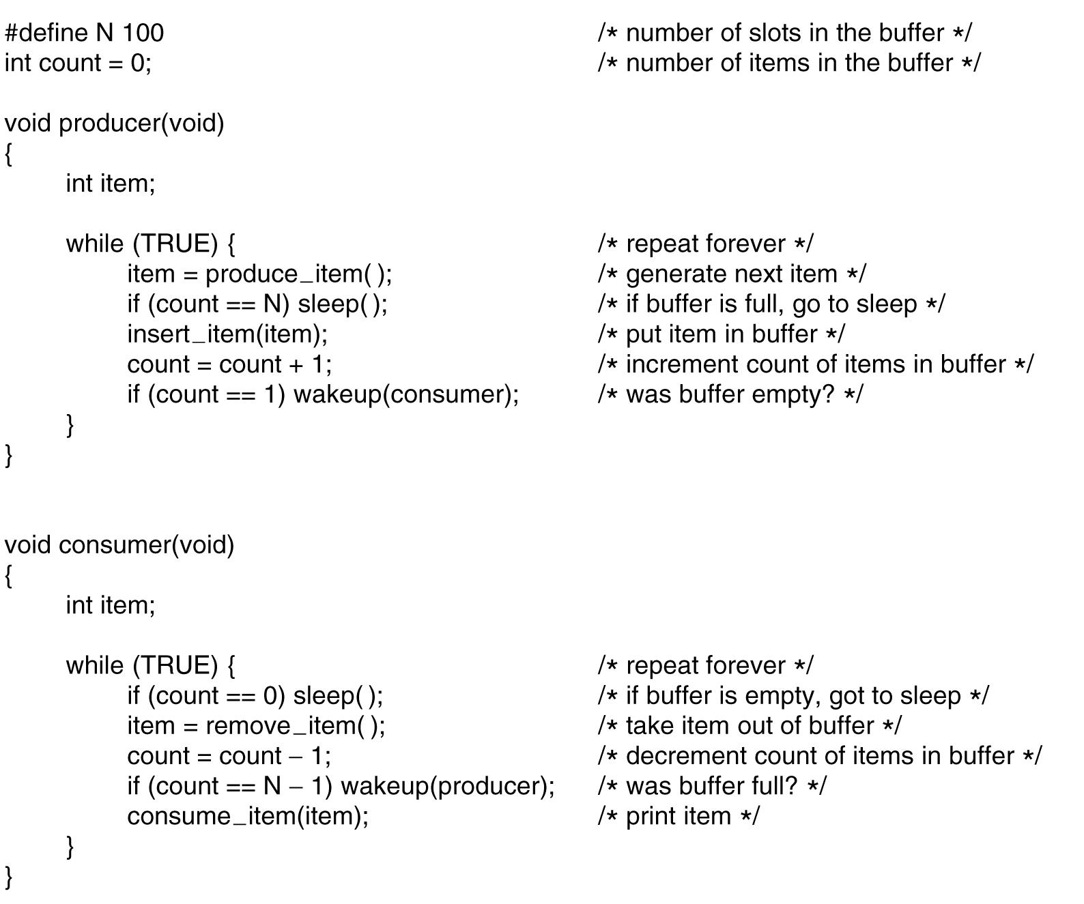
InterProcess Communication (IPC) Producer-Consumer Problem (cont)
There are two problems:
Uncontrolled concurrent access to variable count
Wakeup signalization can be lost
Tanenbaum, Fig. 2-27.

Slide 41


InterProcess Communication (IPC) Producer-Consumer Problem (cont)
Above functions are executed incorrectly at the statements “count = count + 1” of producer and “count = count – 1” of consumer if the functions run concurrently
Suppose that the value of the variable counter is 5.
Then the value of the variable of counter may be 4, 5, or 6!!
Two statements may be implemented in a machine language as

Slide 42
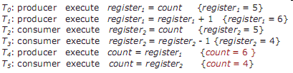
InterProcess Communication (IPC) Producer-Consumer Problem (cont)
The first problem:
Uncontrolled concurrent access to variable count
The second problem
Wakeup signalization can be lost
Problems
The buffer is empty and the consumer has just read count = 0 → consumer sleep, producer wakeup and insert data
Count =1, consumer is sleeping, thus the producer calls wakeup consumer
Consumer is not yet logically asleep, so the wakeup signal is lost

Slide 43
InterProcess Communication (IPC) Semaphores
(E.W.Dijkstra, 1965):
A new variable type (semaphore) could have
The value 0: no wakeups were saved
The positive value: one or more wakeups were pending
Two operations
down (sleep)
Checking the semaphore value is greater than 0
If so, it decrements its value & continues, otherwise blocks the current process
checking the value, change it, and possibly going to sleep, are all done as single, indivisible atomic action
Once a semaphore operation has started, no other process can access the semaphore until the operation has completed or blocked
up (wakeup)
increments the semaphore’s value and wakes up a sleeping process (indivisible)
no process ever blocks doing an up, just as no process ever blocks doing a wakeup in the earlier model
Semaphores solve the lost-wakeup problem

Slide 44
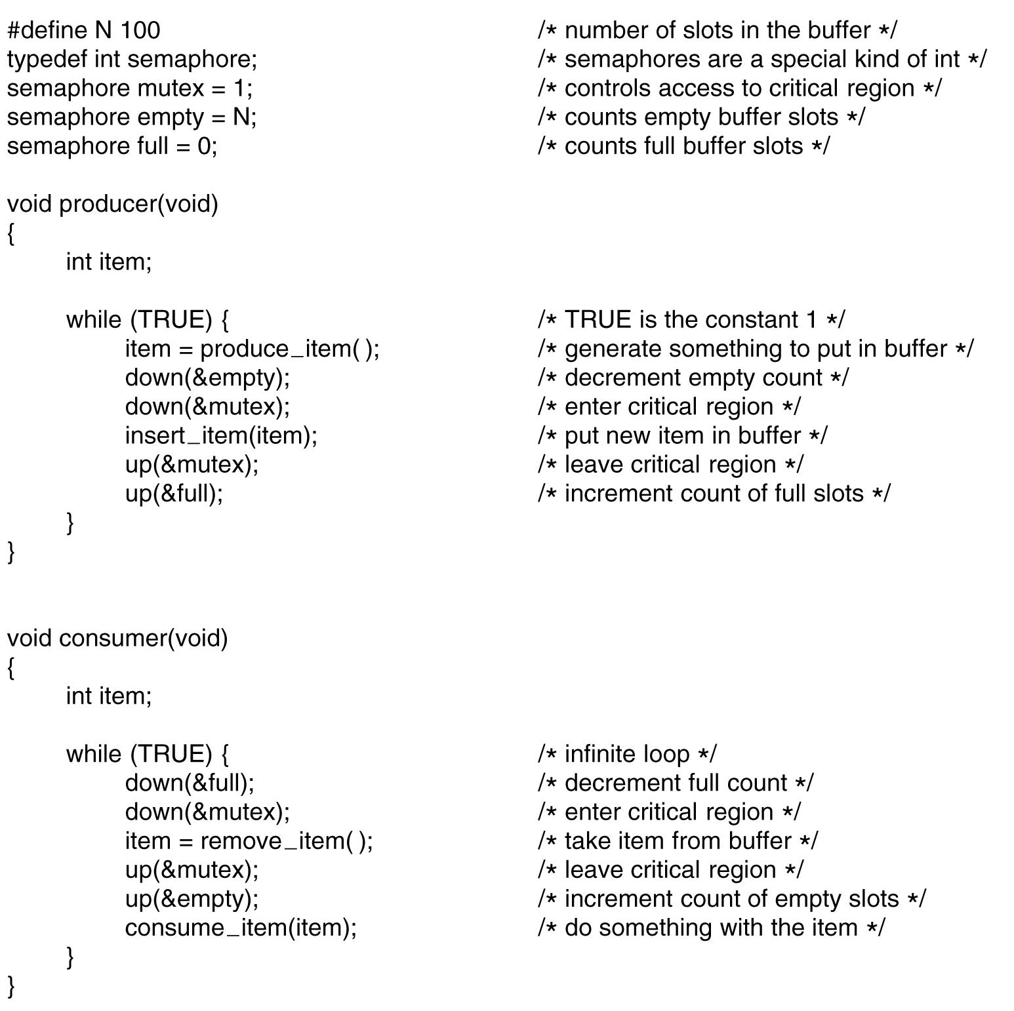
InterProcess Communication (IPC) Solving Producer-Consumer Problem
Uses 3 semaphores
full: counting the full slots (0)
empty: counting the empty slots (n slots)
mutex: make sure the producer and consumer do not access the buffer (1)

Slide 45
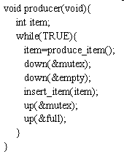
InterProcess Communication (IPC) Solving Producer-Consumer Problem
There are two ways of using semaphores:
Mutual exclusion–binary semaphores(on 2 processes)
Only one process can enters its critical region (reading or writing the buffer) at the same time
Synchronization – Condition checking
Ensure the producer stops running when the buffer full and the consumer stops running when it is empty
That leads to complicated and tricky solutions that can generate deadlocks
Two downs were reversed in order in the producer
So, mutex was decremented before empty
If buffer is full, mutex equals 0 before empty decrease → producer is blocked
In next time, the consumer tried to access the buffer, it would do down on mutex to 0 → consumer is also blocked, too
→ both producer and consumer are blocked forever
→ be careful to use semaphores

Slide 46
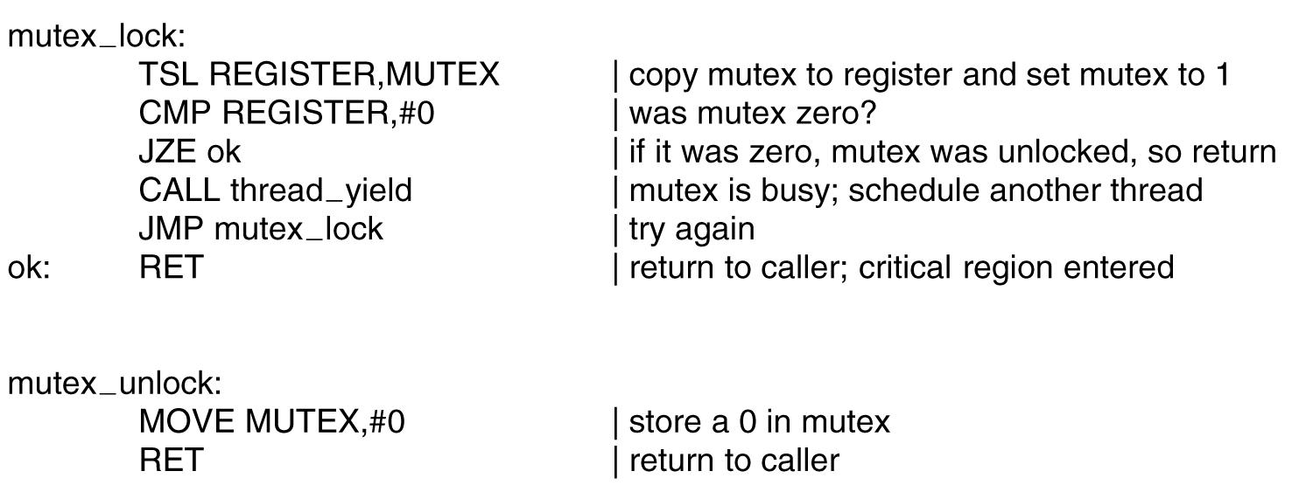
InterProcess Communication (IPC) Mutexes
Good for managing mutual exclusion to some shared resource or piece of code (it is easy and efficient to implement using thread in user mode)
A mutex is a variable that can be in one of two states
unlocked (0): the calling threads is free to enter the critical region
locked (1): the calling thread is blocked until the thread in the critical region is finished (busy)
Two procedures are used
mutex_lock: is called when a thread needs access to a critical region
mutex_unlock: is called when a thread in the critical region is finished
Tanenbaum, Fig. 2-29.

Slide 47
InterProcess Communication (IPC) Monitors
Is a proposal of Brinch Hansen (1973) and Hoare (1974)
Is a collection of procedures, variables, and data structures that are all grouped together in a special kind of module or package
Processes may call the procedures in a monitor whenever they want to, but they cannot directly access monitor‘s internal data structures from procedures declared outside the monitor (encapsulation)
Only one process can be active in a monitor at any moment (mutual exclusion)
Monitor are programming language constructs
When a process calls a monitor procedure, it must check to see if any other procedure in currently active within monitor
If so, the calling process is suspended until the other leaves.
Otherwise, it enters the monitor
Monitor are implemented using
Mutual exclusion in monitor is ensured by the compiler
Condition variables: provide the possibility of waiting

Slide 48
InterProcess Communication (IPC) Condition Variables
Used to wait for a specific condition to be fulfilled
Two operations
wait(): current process sleep, waiting (block state)
signal(): a sleeping process is awaked
When a process call wait, the other processes get access into the monitor
The wait must come before the signal and keep track the state of each process with variables to ensure the signal losing

Slide 49
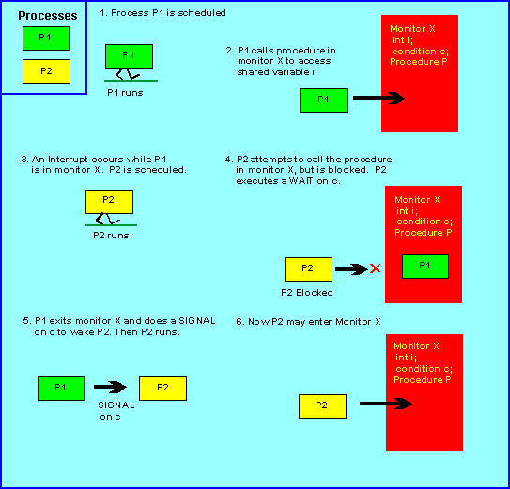
InterProcess Communication (IPC) Monitor functions

Slide 50
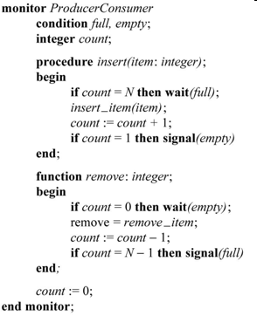
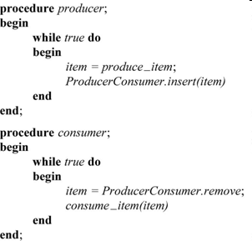
InterProcess Communication (IPC) Solving Producer-Consumer Problem
Tanenbaum, Fig. 2-34.

Slide 51
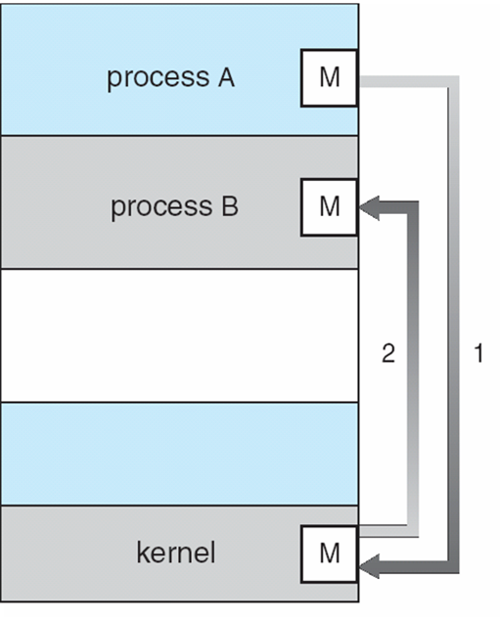
InterProcess Communication (IPC) Message Passing
Using system calls (like semaphore) with 2 primitives
send (destination, &message): sends a message to given destination
receive (source, &message): receives a message from a given resource. If no message is available, the receiver can block until one arrives
Message-Passing System is used for the communicating processes are on different machines connected by a network
To guard against lost messages, sender and receiver can agree that as soon as a message has been received, the receiver will send back a special acknowledgement message (ensuring both process are blocked forever)

Slide 52
InterProcess Communication (IPC) Solving Producer-Consumer Problem
Tanenbaum, Fig. 2-36.

Slide 53
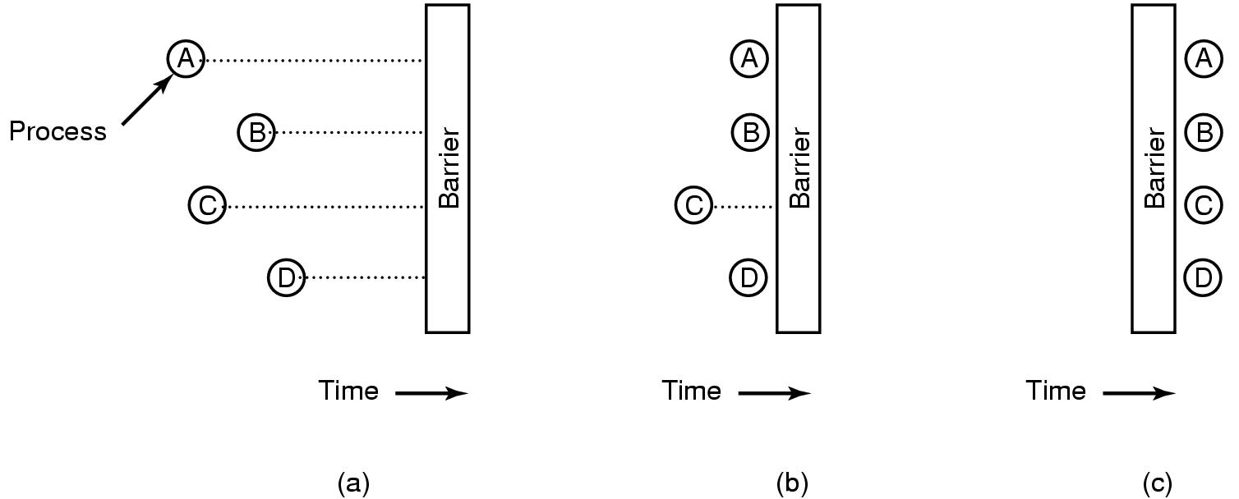
InterProcess Communication (IPC) Barriers
Is intended for groups of processes rather than two process producer-consumer type situations
The applications are divided into phases and have the rule that no process may proceed into the next phase until all processes are ready to proceed to the next phase.
This behavior may be archived by placing a barrier at the end of each phase. When a process reaches the barrier, it is blocked until all processes have reached the barrier.
Tanenbaum, Fig. 2-37.

Slide 54
Summary
InterProcess Communication
Q&A

Slide 55
Next Lecture
Scheduling
Scheduling Criteria/ Properties
Scheduling decisions are applied to determine which processes are executed (algorithms or mechanism)
Scheduling on Processes and Threads

